Slide 1
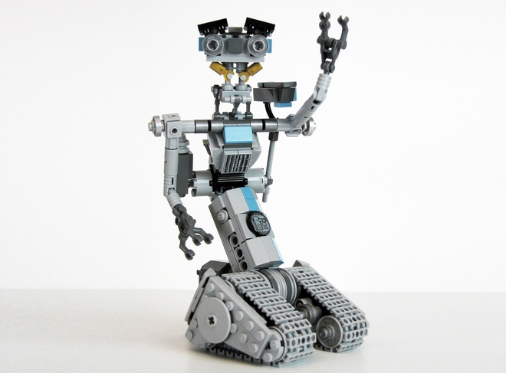
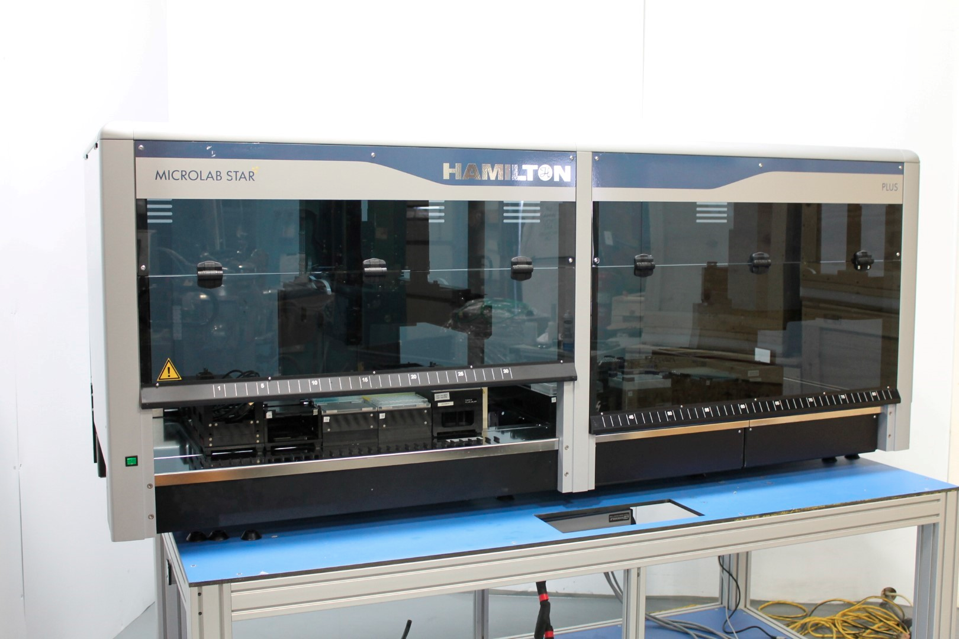


Automation of single-cell genomics workflows
Center of Human Genetics
Thierry Voet lab
Daniel Brown
Notes:
Reduce hands-on time
Improve throughput
Be more like the guy on the right

Slide 2
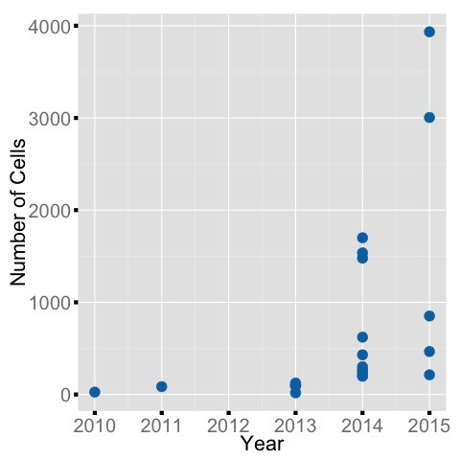
Overview
Best practices
Single-cell genomics workflow
Implementation
Next Gen Seek blog: nextgenseek.com/
Notes:
The number of cells profiled in a single-cell study has greatly increased in recent years

Slide 3
Practical differences between bulk and single-cell experiments
Bulk genomics
1 sample = 1 NGS library
Low to no amplification
High efficiency
Stream-lined protocols
Single-cell samples
1 sample = many libraries
More manipulation
Low efficiency
Rapidly changing protocols
Cost shifts from sequencing to sample preparation
Notes:
Single-cell is lower complexity/ molecules, therefore more multiplexing
In the age of the 1000 dollar genome the major cost is sample prep.

Slide 4
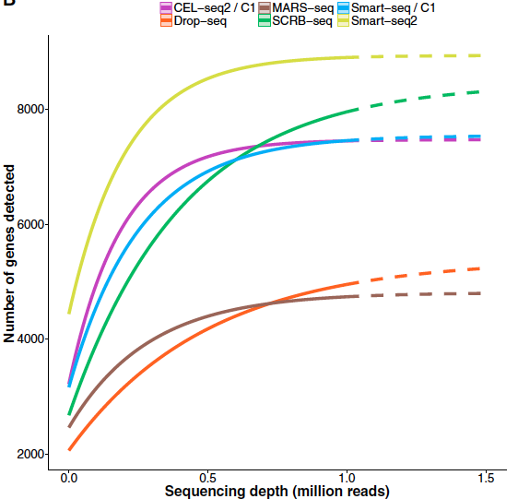
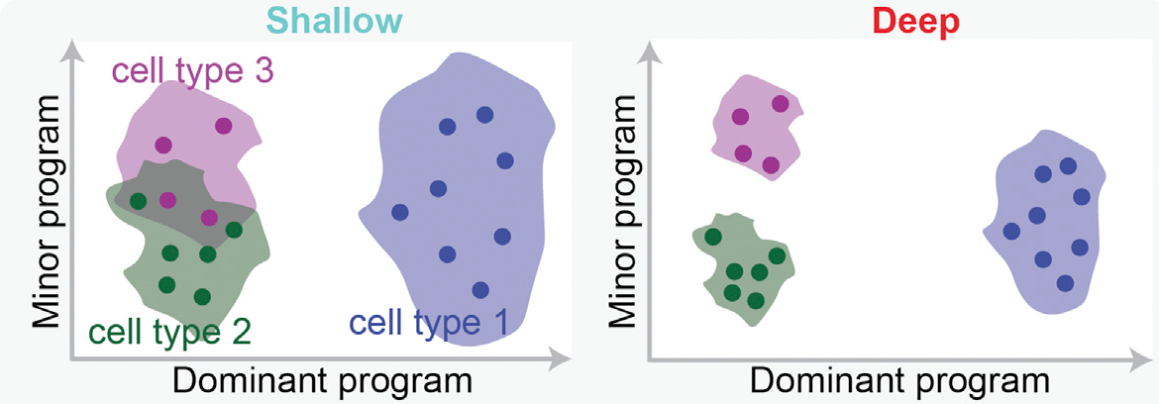
Method and sequencing depth is dependent on experimental aim
Ziegenhain et al., 2016 Molecular Cell
Heimberg et al., 2016 Cell systems

Slide 5
Microwell plates vs Droplets
Microliter volumes
Hundreds of cells per run
Euros per cell
Know each cells location
Index sorting
Compatible with existing protocols
Nanolitre volumes
Thousands of cells per run
Cents per cell
Difficult to add reagents
No Mixing
Dead volume
Notes:
Because of tubing feeding the microfludic chips there is a dead volume. Need a few thousand cells
With droplets downstream steps like library prep must be done on aliquots.
The 2 techniques are complementary. Use Droplets for a course view of the number of subpopulations and identify highly expressed genes to use as markers.
Then use FACS to target a subpopulation of interest to characterize in greater detail using plates.

Slide 6
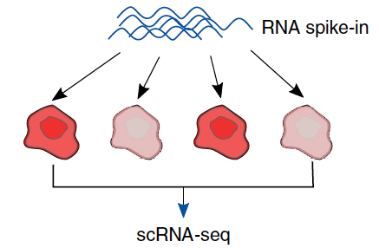
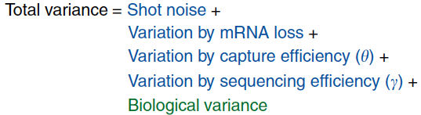
Optimizations
Cell isolation
PCR cycles
ERCC concentration
Kim et al., 2015 Nature Commications
Notes:
Before we can start producing data we need some optimization
Shot noise is poisson noise.
Biological variation is what you are interested in

Slide 7
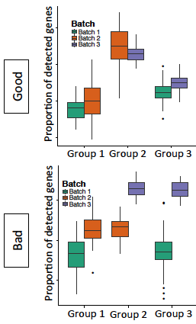
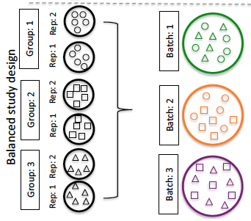
Batch effects and experimental design
Split samples across processing batches
Plates
Chips
Allows deconvolution of technical effects
Hicks et al., 2015 BioRxiv
(preprint)

Slide 8
Setting up an automated single-cell workflow
Obtained heavy equipment grant from Stichting tegen kanker
Setup high throughput single-cell genomics workflow
From cell isolation to sequencing to analysis
Notes:
When I joined the lab in January

Slide 9
Single-cell workflow

Slide 10
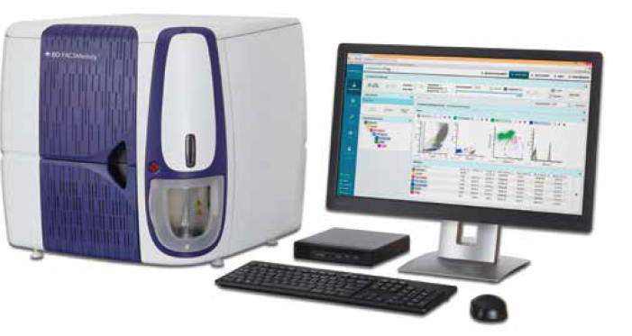
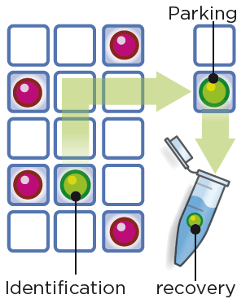
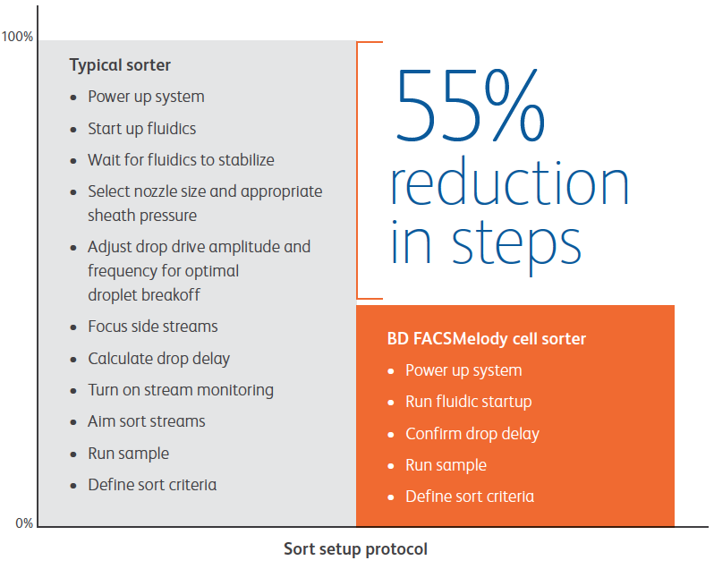
Cell isolation systems
FACS Melody
DEPArray NxT
Notes:
Automated startup in less than 15 minutes
3 colours.
DEParray is a visual based cell isolator with a microscopy based system.
Dielectrophoresis (DEP) principles to individual cells, through and array of electrodes.
Isolate cancer stem cells, brain cell types using microscopy visually confirm

Slide 11
Automated single-cell workflow

Slide 12
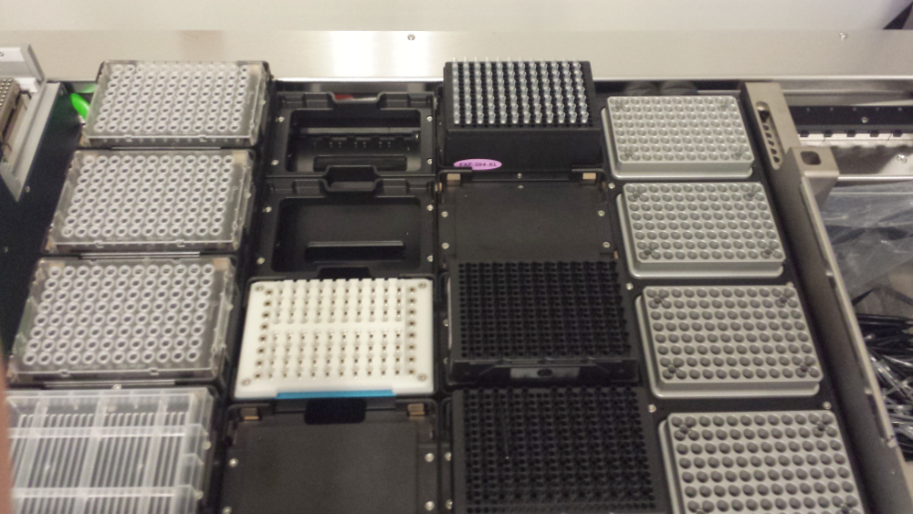
Hamilton Microlab Star Plus Pre-PCR
384 well head
8 x 1000uL channels
Heater / shaker
Centrifuge
On Deck Thermocycler
Cold station

Slide 13
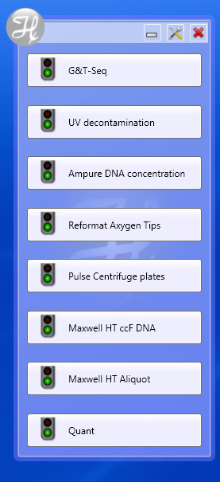
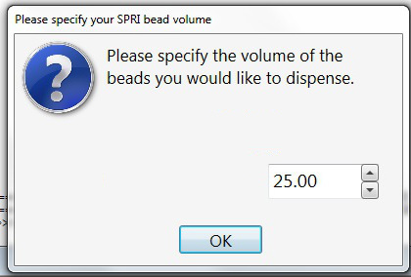
User friendly to run assays

Slide 14
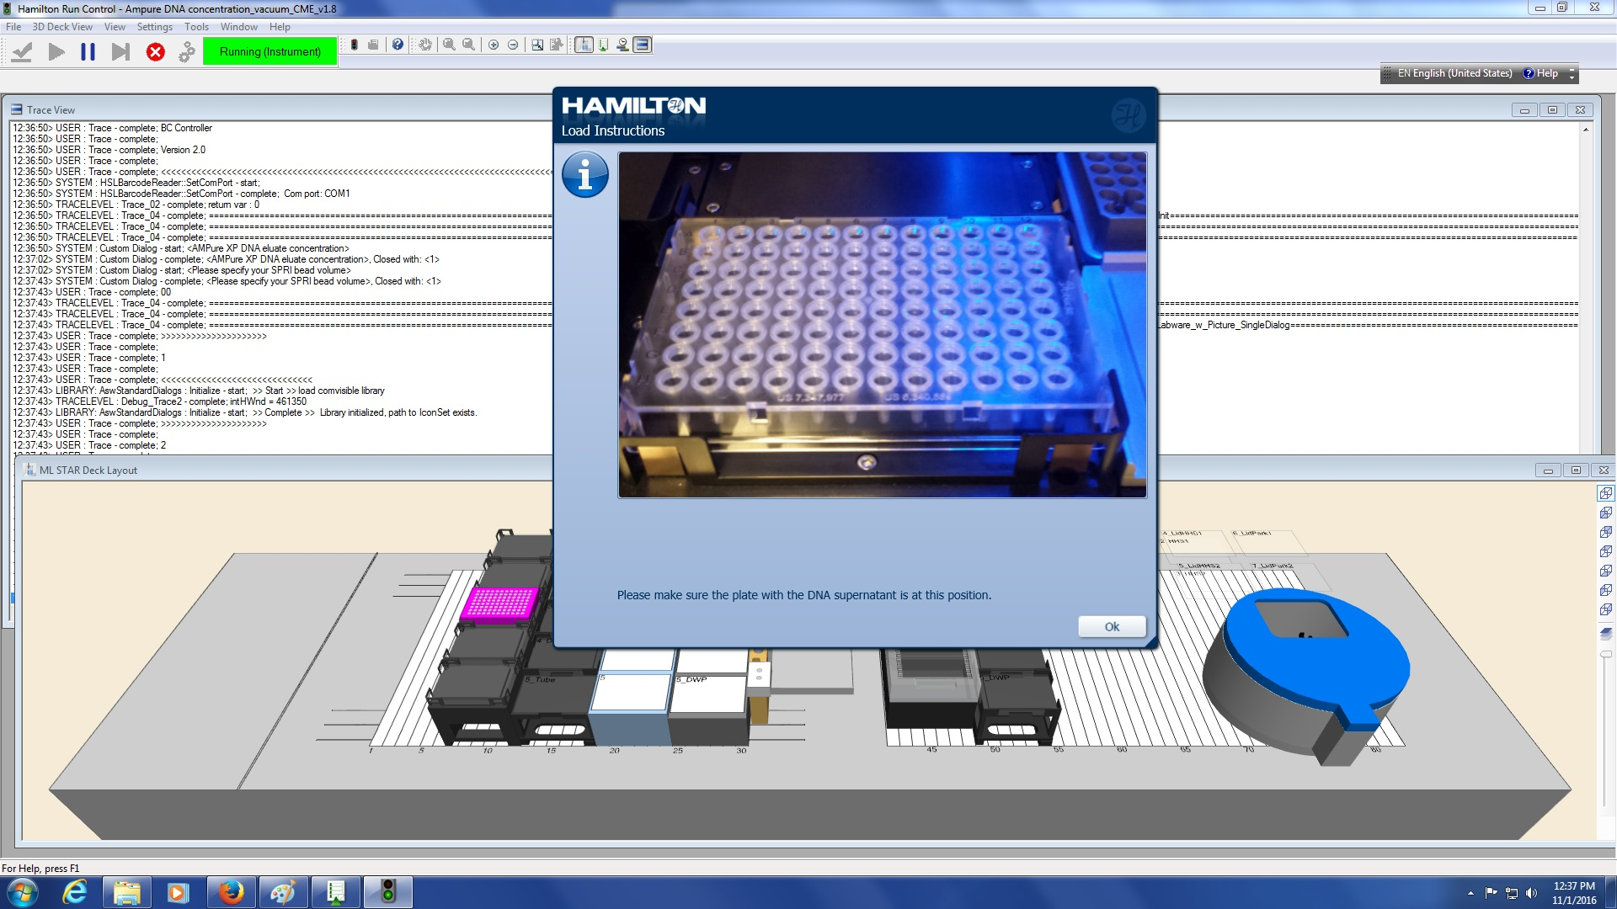
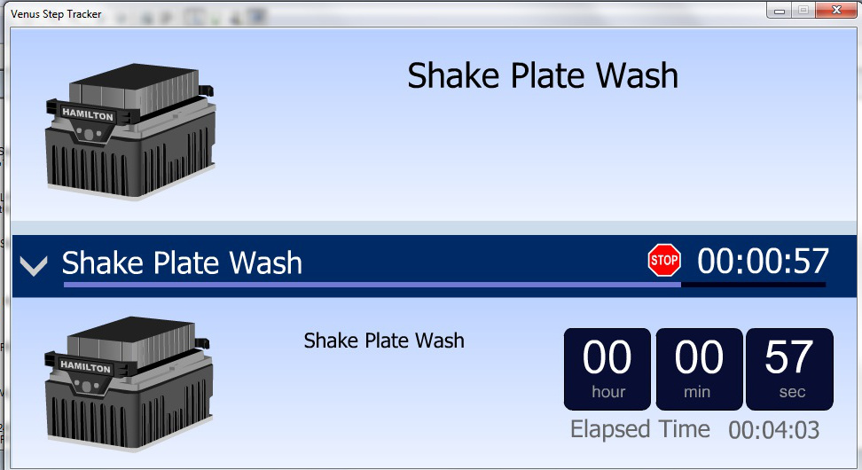

Slide 15
Single-cell workflow

Slide 16
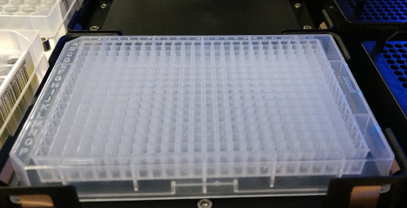
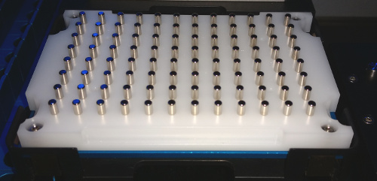
Hamilton Microlab Star Post-PCR
Pre-PCR currently performed in 96 well
Plate reformatting for clean-up 4 x 96 well -> 1 x 384 well plate
Minimize changing of tips
Trace samples with mapping file
Standard PCR cleanup with SPRI beads
Optimize pipetting of solutions with PEG and ethanol
Notes:
By having 1 plate instead of 4 we minimize the changing of tips

Slide 17
Single-cell workflow

Slide 18
Quality control When can I know if it worked?
Decision point after amplifying samples
DNA quantification and fragment analysis performed manually
10% of samples
Costly to QC every sample (sequencing cheaper)
Discard poor samples in sequencing QC

Slide 19
Single-cell workflow

Slide 20
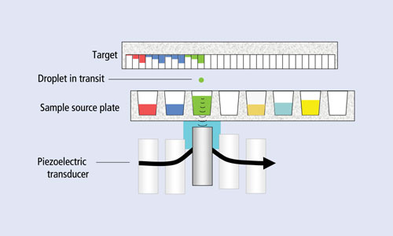
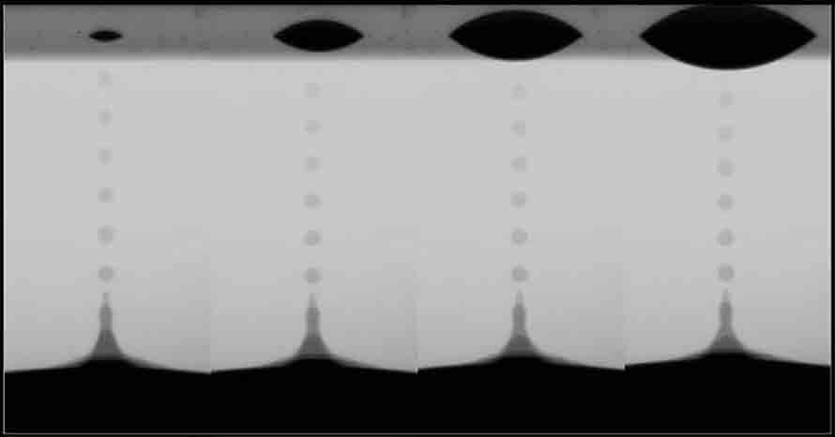
Preparation of NGS libraries using nanolitre volumes
Labcyte Echo 525 Acoustic droplet ejector
for Nextera XT reaction (DNA shearing and adapter ligation)
Nanolitre dispensing
High accuracy and precision
Speed
Easy to program
No tips
Limitations
High dead volume
Notes:
1 drop is 25nl
Acoustic transducer applies a force that ejects a drop from source to destination plate
No tips means less contamination

Slide 21
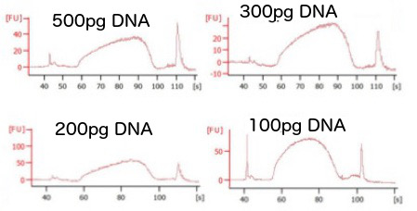
Illumina library preparation in nanolitre volumes
Reduce hands on time from 2 hours to 15 minutes
Cost from €25 per sample to €2.5 per sample
Substituted some Nextera XT kit reagents to further reduce costs
0.1% SDS for buffer NT
Q5 polymerase for NPM reagent
Custom transposase planned
Notes:
Kit for 96 samples is 2500 EUR

Slide 22
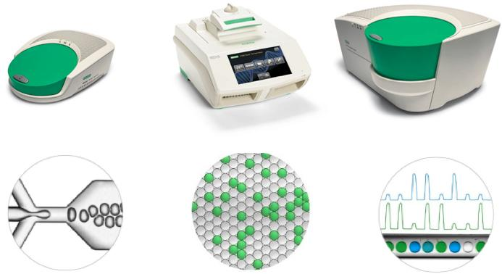
Single-cell workflow
Biorad Digital Droplet PCR

Slide 23
Reproducing Macaulay et al., 2015 Nat Methods G&T-Seq Single-cell RNA-seq
Sebastiaan Vanuytven
Notes:
Method developed in Thierry’s lab at WTSI
We used the same cell type
Graph is our cells and theirs together
Clusters represent cell type not geographical location

Slide 24
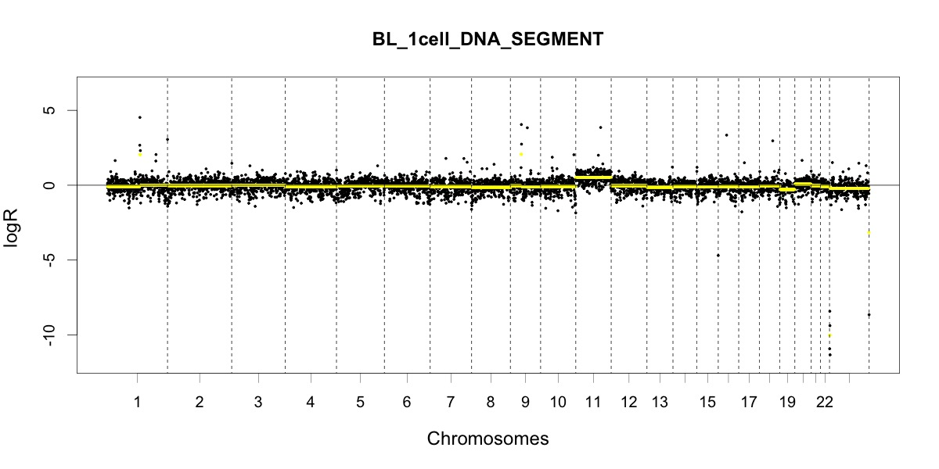
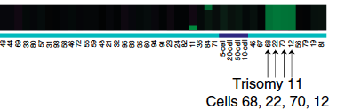
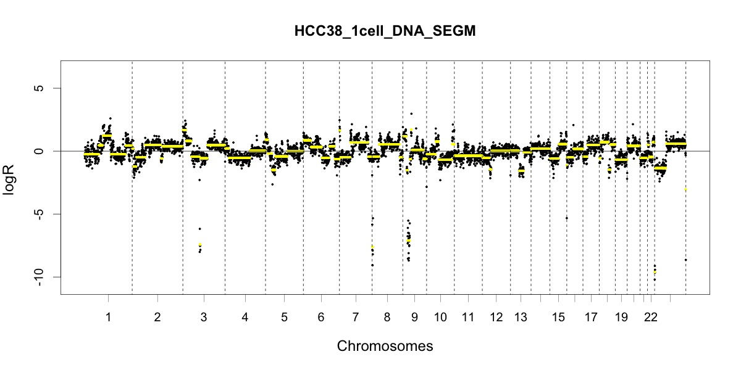
Reproducing Macaulay et al., 2015 Nat Methods G&T-Seq Single-cell DNA-seq
Normal
Tumour
Macaulay et al 2015
Notes:
Reproduced trisomy of chromosome 11 in BL

Slide 25
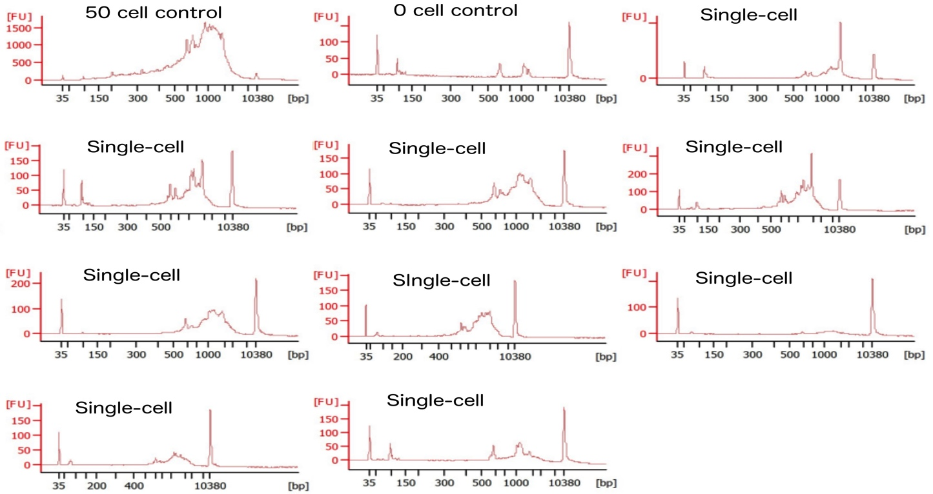
SMART-seq2
Adapted from Picelli et al 2014 Nat Protocols
Nina Dedoncker
Notes:
First method made available to Genomics Core is SMART-Seq
Pre, Post and Library prep automated
Right hand side is QC of amplified cDNA. We request a multi-cell and no cell control

Slide 26
Consistency in scRNA-Seq library size and number of genes detected
Notes:
In a larger dataset generated by a collaborator we find relatively even library size
Well B5 probably no cell sorted
Well B6 is potentially a doublet

Slide 27
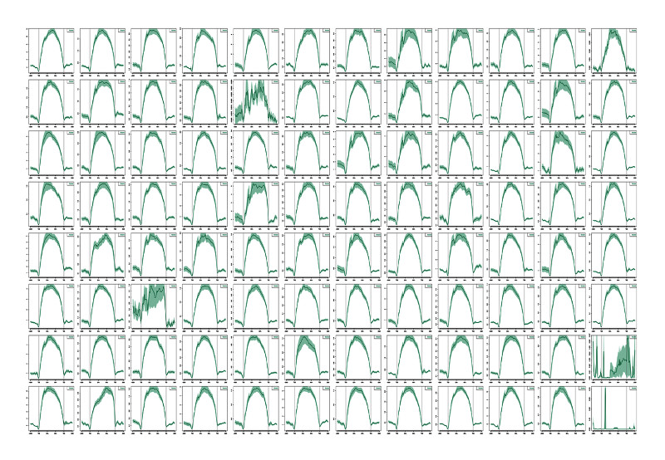
Full transcript coverage with SMART-Seq2
Alejandro Sifrim
Notes:
No mRNA degradation

Slide 28
Additional assays under development
Picogreen quantification
Cel-seq2 (Kristofer Davie)
384 well SMART-seq
scNXT-seq
Additional combined DNA and RNA-Seq methods
ATAC and RNA-Seq

Slide 29
Acknowledgments
Department of Human Genetics, KU Leuven, Belgium
Thierry Voet
Sebastiaan Vanuytven
Parveen Dabas
Alejandro Sifrim
Nina Dedoncker
Koen Theunis
Elia Fernandez Gallardo
Sarah Geurs
Jenny Moon
Swell Sieben
Joris Vermeesch
KU/ UZ Leuven Genomics Core
Celine Helsmoortel
Wim Meert
Vanessa Brys
Stephanie Deman
Jeroen Van Houdt
Earlham Institute, UK
Iain Macaulay
Single Cell Genomics Core Facility, WTSI, UK
Stephan Lorez
Iraad Bronner
Jose Garcia-Bernardo
Laboratory of Computational Biology
Kristofer Davie
Hamilton Germany GmbH
Bart Minnoye
Notes:
Celine Helsmoortel
Wim Meert
Vanessa Brys
Stephanie Deman
Jeroen Van Houdt

